Slide 1
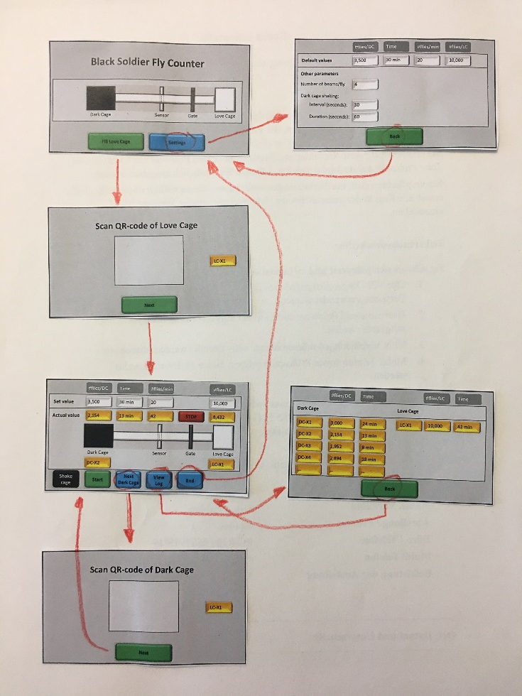

Slide 2
Explanation
Such rounded boxes are buttons which can be pressed
Start
End
Yellow boxes show information but cannot (directly) be edited
DC-X2
White boxes can be pressed and then be edited with a pop-up number pad
10,000

Slide 3
Black Soldier Fly Counter
Dark Cage
Sensor
Gate
Love Cage
Fill Love Cage
Settings

Slide 4
#flies/DC
Time
#flies/min
#flies/LC
Default values
3,500
30 min
20
10,000
Other parameters
Number of beams/fly
4
Dark cage shaking:
Interval (seconds):
30
Duration (seconds):
60
Back

Slide 5
Scan QR-code of Love Cage
LC-X1
Next

Slide 6
#flies/DC
Time
#flies/min
#flies/LC
Set value
3,500
30 min
20
10,000
Actual value
2,154
13 min
42
STOP
8,432
Dark Cage
Sensor
Gate
Love Cage
DC-X2
LC-X1
Shake cage
Next Dark Cage
View Log
Start
End

Slide 7
Dark Cage
#flies/DC
Time
Love Cage
#flies/LC
Time
DC-X1
3,000
24 min
LC-X1
10,000
42 min
DC-X2
2,154
13 min
DC-X3
1,952
8 min
DC-X4
2,894
18 min
…
…
…
Back

Slide 8
Scan QR-code of Dark Cage
LC-X1
Next

